Slide 1
Real-time Specialization
Prepared By :
Manoj Kafle (Roll No: 13)
Suraj Neupane (Roll No: 14)
Notes:
Good Morning Everyone! I would like to thanks Prof. Dr. Subarna Shakya for providing an opportunity to present on Real-time specialization.

Slide 2
Contents
Introduction
Abstract Model Of Real-time System
Classification On Real-time System
Issues In Real-time System
Analysis
Construction
Testing and Verification
Notes:
Here we are introducing What is real-time system? Examples, its abstract model, classification, fundamental Issues and its summary. And How its analysis, construction, Testing and Verification are done? First of all lets have a look we are getting into its introduction. Next…

Slide 3
Introduction
A system is said to be real-time, “If it is required to complete its work and deliver its service on time”.
Correctness depends not only on the logical result of computation but also on the time at which the results are produced.
Example: Aircraft, Missile (Hard Real-time system) and Telephones, DVD Players (Soft Real-time system)
Notes:
Important thing is timely accomplishing the task is the must. And its correctness depends not only on the logical result of computation but also on time at which results are produced. There are some example that is distinguished by Hard and soft real-time system. Some example are … Aircraft, Missile as Hard Real-time system and Telephones, DVD Players as Soft Real-time system. We are going to explain this on classification of real-time system later. Now lets have a look on Abstract model of Real-time system.

Slide 4
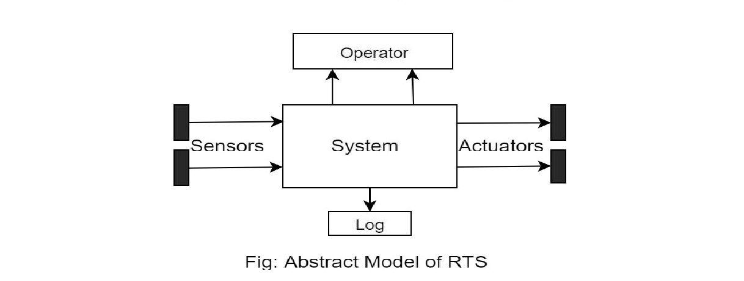
Abstract Model Of RTS
Sensor and Actuator providing real-time view of application behaviors.
RTS has means of observing what’s going on, Controlling Processing from operator and keeping history via logging.
Notes:
Here, For Example: Automatic Flight Control System consists of several sensors for various tasks like speed control, height monitoring, position tracking, status of doors, obstacle detection, fuel level etc. Actuators on aircraft perform a number of important functions such as adjusting flight control surfaces like the elevator, rudder, ailerons, flaps, slats and spoilers, extending and retracting landing gear, positioning engine inlet guide vanes and thrust reversers, and opening and closing cargo or weapon bay doors. And RTS has means of observing what’s going on, Controlling Processing from operator and keeping history via logging. Now, the next thing will be classification of real-time system. Lets have a look on it. Next…

Slide 5
Classification On Real-time System
Hard Real-time System
Deterministic predictability of processes execution is essential property.
We must be able to guarantee processing of all critical periodic and aperiodic processes.
In applying OOSE to hard real-time systems, a more direct relationship between the execution properties of processes within selected or alternative resource structures and the deadline requirements must be taken into account.
Fault tolerance is essential in this type of system.
Example: Missile, Aircraft etc.
Soft Real-time System
Quality and performance is measured in terms of service provided.
While it is quite possible analytically to place bounds on such systems
System in which one or more failures to meet the deadline is not considered as complete system failure, but its performance is considered degraded.
In applying OOSE to non-hard real-time systems, the specialization is based on the functionality and the degree of service achievable within the resource structure.
Example: Live Streaming, DVD Players etc.
Notes:
In Hard Real-time System Deterministic predictability of process execution is essential property as illustrated. We must be able to guarantee processing of all critical periodic and aperiodic processes.
On the other hand, In soft Real-time system : Quality and performance is measured in terms of service provided.

Slide 6
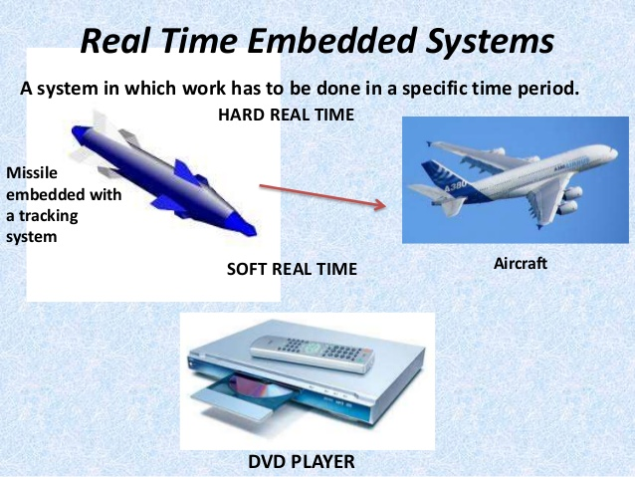
Hard Real-time Systems & Soft Real-time System
Notes:
Here are some examples of Real time embedded system where a system in which work has to be done in a specific time period. Where hard real-time embedded systems, work has to be done in a specific time period.

Slide 7
Issues In Real-time System
Designing Real-time systems is a challenging task.
Most of the challenge comes from the fact that Real-time systems have to interact with real world entities.
These interactions can get fairly complex.
A typical Real-time system might be interacting with thousands of such entities at the same time.
For example, a telephone switching system routinely handles calls from tens of thousands of subscriber. The system has to connect each call differently. Also, the exact sequence of events in the call might vary a lot.

Slide 8
Issues In Real-time System
Real-time Response
Recovering from Failures
Working with Distributed Architectures
Asynchronous Communication
Race Conditions and Timing

Slide 9
Real-time Response
Real-time systems have to respond to external interactions in a predetermined amount of time.
Successful completion of an operation depends upon the correct and timely operation of the system.
Design the hardware and the software in the system to meet the Real-time requirements.
For example, a telephone switching system must feed dial tone to thousands of subscribers within a recommended limit of one second. To meet these requirements, the off hook detection mechanism and the software message communication involved have to work within the limited time budget.
The system has to meet these requirements for all the calls being set up at any given time.

Slide 10
Questions to be asked
Is the architecture suitable? If message communication involves too many nodes, it is likely that the system may not be able to meet the Real-time requirement due to even mild congestion. Thus a simpler architecture has a better chance of meeting the Real-time requirements.
Are the link speeds adequate? Generally, loading a link more than 40-50% is a bad idea. A higher link utilization causes the queues to build up on different nodes, thus causing variable amounts of delays in message communication.
Are the processing components powerful enough? A CPU with really high utilization will lead to unpredictable Real-time behavior. Also, it is possible that the high priority tasks in the system will starve the low priority tasks of any CPU time. This can cause the low priority tasks to misbehave. As with link, keep the peak CPU utilization below 50 %.
Is the Operating System suitable? Assign high priority to tasks that are involved in processing Real-time critical events. Consider preemptive scheduling if Real-time requirements are stringent. When choosing the operating system, the interrupt latency and scheduling variance should be verified.

Slide 11
Recovering from Failures
Real-time systems must function reliably in event of failures.
These failures can be internal as well as external.
Internal failures can be due to hardware and software failures in the system.

Slide 12
Internal Failures
Software Failures in a Task: Unlike desktop applications, Real-time applications do not have the luxury of popping a dialog box and exiting on detecting a failure. Design the tasks to safeguard against error conditions. This becomes even more important in a Real-time system because sequence of events can result in a large number of scenarios. It may not be possible to test all the cases in the laboratory environment. Thus apply defensive checks to recover from error conditions. Also, some software error conditions might lead to a task hitting a processor exception. In such cases, it might sometimes be possible to just rollback the task to its previous saved state.
Processor Restart: Most Real-time systems are made up of multiple nodes. It is not possible to bring down the complete system on failure of a single node thus design the software to handle independent failure of any of the nodes. This involves two activities.
Board Failure: Real-time systems are expected to recover from hardware failures. The system should be able to detect and recover from board failures. When a board fails, the system notifies the operator about it. Also, the system should be able to switch in a spare for the failed board. (If the board has a spare)
Link Failure: Most of the communication in Real-time systems takes place over links connecting the different processing nodes in the system. Again, the system isolates a link failure and reroutes messages so that link failure does not disturb the message communication.

Slide 13
External Failure
Invalid Behavior of External Entities: When a Real-time system interacts with external entities, it should be able to handle all possible failure conditions from these entities. A good example of this is the way a telephone switching systems handle calls from subscribers. In this case, the system is interacting with humans, so it should handle all kinds of failures, like:
Subscriber goes off hook but does not dial
Toddler playing with the phone!
Subscriber hangs up before completing dialing.
Inter Connectivity Failure: Many times a Real-time system is distributed across several locations. External links might connect these locations. Handling of these conditions is similar to handling of internal link failures. The major difference is that such failures might be for an extended duration and many times it might not be possible to reroute the messages.

Slide 14
Working with Distributed Architectures
Maintaining Consistency: Maintaining data-structure consistency is a challenge when multiple processors are involved in feature execution. Consistency is generally maintained by running data-structure audits.
Initializing the System: Initializing a system with multiple processors is far more complicated than bringing up a single machine.
Inter-Processor Interfaces: One of the biggest headache in Real-time systems is defining and maintaining message interfaces. Defining of interfaces is complicated by different byte ordering and padding rules in processors.
Load Distribution: When multiple processors and links are involved in message interactions distributing the load evenly can be a daunting task. If the system has evenly balanced load, the capacity of the system can be increased by adding more processors
Centralized Resource Allocation: Distributed systems may be running on multiple processors, but they have to allocate resources from a shared pool. Shared pool allocation is typically managed by a single processor allocating resources from the shared pool. If the system is not designed carefully, the shared resource allocator can become a bottle neck in achieving full system capacity.
Notes:
Initializing the System: In most systems the software release is resident on the OMC. The node that is directly connected to the OMC will initialize first. When this node finishes initialization, it will initiate software downloads for the child nodes directly connected to it. This process goes on in an hierarchical fashion till the complete system is initialized.
Inter-Processor Interfaces: Maintenance of interfaces is complicated by backward compatibility issues. For example if a cellular system changes the air interface protocol for a new breed of phones, it will still have to support interfaces with older phones.
Load Distribution: Such systems are said to scale linearly with increasing processing power. But often designers find themselves in a position where a single processor or link becomes a bottle neck. This leads to costly redesign of the features to improve system scalability.

Slide 15
Asynchronous Communication
Remote procedure calls (RPC) are used in computer systems to simplify software design. RPC allows a programmer to call procedures on a remote machine with the same semantics as local procedure calls. RPCs really simplify the design and development of conventional systems, but they are of very limited use in Real-time systems. The main reason is that most communication in the real world is asynchronous in nature, i.e. very few message interactions can be classified into the query response paradigm that works so well using RPCs.
Thus most Real-time systems support state machine based design where multiple messages can be received in a single state. The next state is determined by the contents of the received message. State machines provide a very flexible mechanism to handle asynchronous message interactions. The flexibility comes with its own complexities. We will be covering state machine design issues in future additions to the Real-time Mantra.

Slide 16
Race Conditions and Timing
It is said that the three most important things in Real-time system design are timing, timing and timing.
Real-time systems deal with timing issues by using timers. Timers are started to monitor the progress of events. If the expected event takes place, the timer is stopped. If the expected event does not take place, the timer will timeout and recovery action will be triggered.
A race condition occurs when the state of a resource depends on timing factors that are not predictable.

Slide 17
Analysis
The use case provided in analysis provide a strong tool to capture real-time requirements.
An example of a hard requirement is a control use case that must be completed within 100ms. An example of a non-hard requirement is that 10000 subscribers shall be able to use a telephone exchange simultaneously.
Time attributes may be related to both periodic (e.g., Frequency) and aperiodic(max response time) processes.
Concurrency requirements, both within and between use case can be included in analysis. It may involve many instances of use case.
During construction, the analysis structure may be modified to accommodate RT requirements.
RT requirements often come from the externals of the system. The sensors and actuators of the system are then often tightly connected to these requirements.
cont…

Slide 18
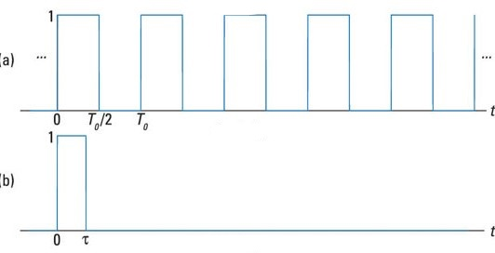
Periodic Vs Aperiodic Processes
Periodic
Aperiodic

Slide 19
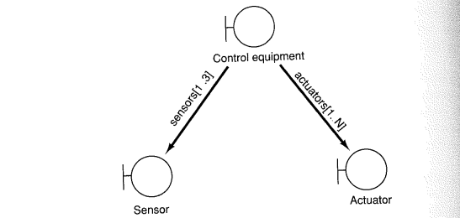
Analysis
Figure shows the use of interface objects to interact with the external system. Alternatively, one can design the sensors and the hardware as internal to the system as an entity object(e.g., temperature gauge), and read values from it using one of its methods.

Slide 20
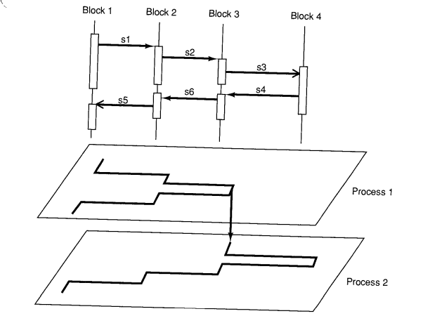
Construction
Real-time systems are often based on process concurrency in the target environment.
Behaviors in the use cases are mapped on to the individual concurrent processes.
Figure shows that processes are orthogonal to objects. i.e., one process may involve many objects and one object may be involved in many processes.
cont…

Slide 21
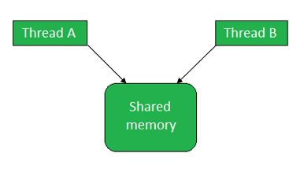
Construction
There may be 2 threads may use the same instance of blocks 3 or there may be 2 instances of the object for two processes.
Threads or lightweight processes simulate processes with shared memory addresses.
It is possible to share an instance between threads, so it is preferred in Object Oriented Programming.
cont…

Slide 22
Construction
OS should support concurrent processes. The semantics( such as RPC, timeouts etc.) from the OS(implementation environment) can then be included in OOSE.
Buffering can be used for synchronization. (one process for incoming stimuli and one process for outgoing stimuli). In some cases the OS can handle mutually exclusive atomic processes.
Time critical function are typical for hard real-time systems. Use cases that involve them must run as separate high-priority processes.
cont…

Slide 23
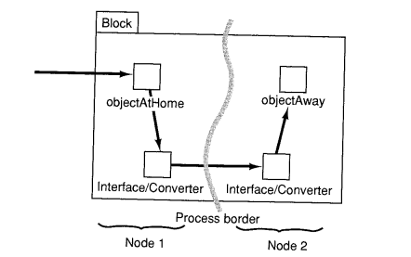
Construction
In distributed environment, the principal strategy is to encapsulate the distribution inside a block.
Tightly coupled objects (with large number of stimuli between them) should be kept in one process to avoid OS overhead on communication.
However, if objects are not coupled, do not place them in the same process even if they have the same periodicity.
cont…
Fig: A distributed block with object modules at different nodes

Slide 24
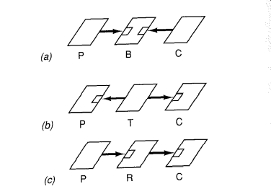

Construction
To handle process communication and synchronization we can introduce intermediate processes(Fig 1, Fig 2) and handle issues such as deadlock, starvation etc.
Fig 1: The principal functionally of processes for (a) buffers (B), (b) transporters (T) and (c) relays (R) P is the producer process and C is the consumer process.
Fig 2: A process configuration that loosens the rendez-vous coupling between P and C.

Slide 25
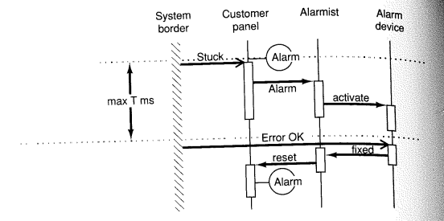
Construction
RT use cases can be described using interaction diagrams.
To handle concurrency problems we use state transition graphs. In these graphs we can see which stimuli can be received at what times and hence get more fault tolerance.
Fig: A real-time requirement from a use case can be allocated to objects using interaction diagrams.

Slide 26
Testing And Verification
Extremely difficult for RT systems.
Hard deadlines may be met most of the times and make it difficult to test.
Processes using common resources may rarely execute simultaneously. Failure can be time dependent and thus difficult to simulate.
Systems may behave differently with debugging tools.

Slide 27


Slide 28
Summary
When strong semantics are provided at the behavioral description level for all these fundamental issues, they radically affect the selection of appropriate resource structure (hardware and system software processes).
All programming languages and most formal methods as well as most contemporary software methods have explicit or implicit means of dealing with these three fundamental issues.
However, when a semantic gap exists between the behavioral description and the implementation environment, typically long lasting complexities are built into the solution that will affect its lifetime and its ability to continue to provide predictable result and satisfactory service as well as maintainability and extendibility. Examples: Ada, HOOD etc.
While the concept used in OOSE provide a useful means of identifying processes, it does not provide any a priori strong semantics for communication and synchronization. Thus, while the problem is addressed in order to match the semantics of the problem with those of the implementation environment.
It is essential to retain strong logical coupling between the application problem and the actual implementation environment to achieve traceability (otherwise it will be very difficult to test the system.

